Slide 1


Jaymart de Leon
November 16th, 2022

Slide 2

Outline
Executive Summary
Introduction
Methodology
Results
Conclusion
Appendix

Slide 3
Executive Summary
Summary of methodologies
Data Collection through API
Data Collection with Web Scraping
Data Wrangling
Exploratory Data Analysis with SQL
Exploratory Data Analysis with Data Visualization
Interactive Visual Analytics with Folium
Machine Learning Prediction
Summary of all results
Exploratory Data Analysis result
Interactive analytics in screenshots
Predictive Analytics result

Slide 4
Introduction
Project background and context
On its website, SpaceX promotes Falcon 9 rocket launches at 62 million dollars; other suppliers charge upwards of 165 million dollars for each launch, and a large portion of the savings is due to SpaceX's ability to reuse the first stage. So, if we can figure out whether the first stage will land, we can figure out how much a launch will cost. If another business wishes to submit a proposal for a rocket launch against SpaceX, they can use this information. The project's objective is to build a machine-learning pipeline to forecast whether the first stage will successfully land.
Problems you want to find answers
What elements determine whether the rocket will successfully land?
The way that different elements interact to affect the likelihood of a successful landing.
What are the requirements must be met to guarantee a successful landing?

Slide 5

Section 1

Slide 6
Methodology
Executive Summary
Data collection methodology:
Data was gathered through scraping Wikipedia’s website and the SpaceX API.
Perform data wrangling
One-Hot Encoding was utilize to categorical features
Perform exploratory data analysis (EDA) using visualization and SQL
Perform interactive visual analytics using Folium and Plotly Dash
Perform predictive analysis using classification models
How to build, tune, evaluate classification models

Slide 7
Data Collection
Describe how data sets were collected.
Data was collected using the get request to the SpaceX REST API
Next, we decoded the response content as a Json the use of .json() junction call and turn it into a pandas dataframe the use of .json_normalize().
I then wiped clean the facts, checked for missing values and fill in missing values where necessary.
Further, I finished internet scraping from Wikipedia for Falcon nine launch statistics with BeautifulSoup.
The goal became to extract the release data as HTML table, parse the table and convert it to an pandas dataframe for future analysis.

Slide 8
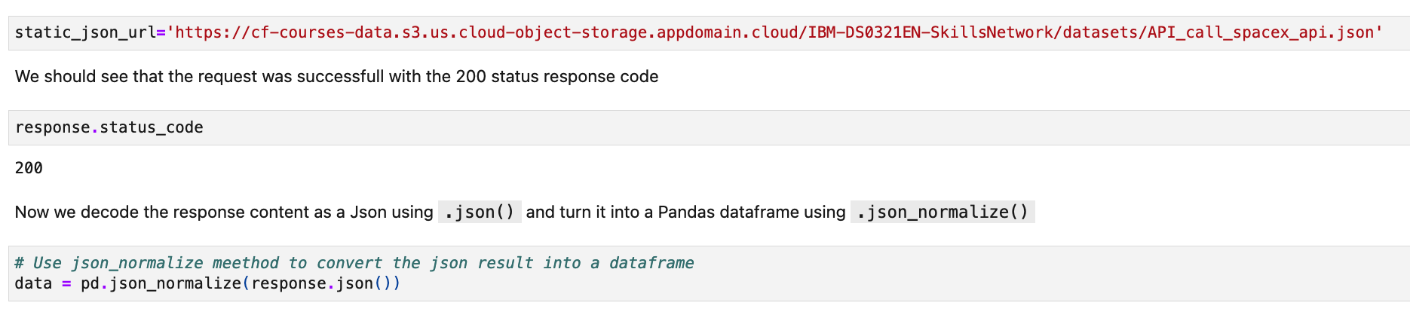
Data Collection – SpaceX API
Used the get request to the SpaceX REST API calls to gather the data, clean, wrangling the data, and formatting
GitHub URL: Data Collection

Slide 9
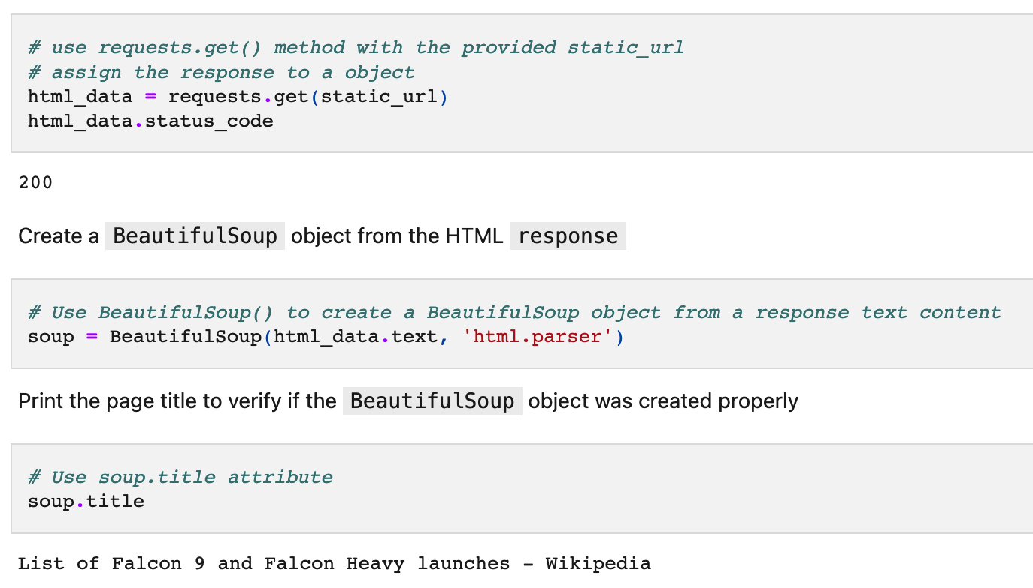
Data Collection - Scraping
Applied webscrapping to scrape Falcon 9 launch records with BeautifulSoup
Then parsed the table and converted it into a pandas dataframe.
GitHub URL: WebScrapping

Slide 10
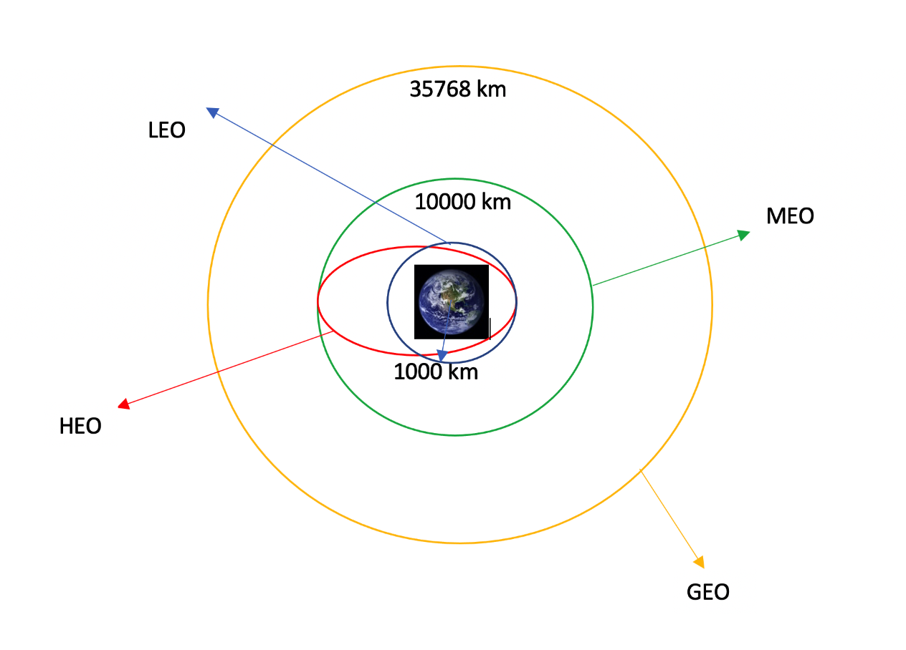
Data Wrangling
Performed exploratory analysis and determined the training labels
Calculated the variety of launches at each website, and wide variety and incidence of each orbits.
Created landing outcome from outcome column and exported the results to .csv file.
GitHub URL: Data Wrangling

Slide 11
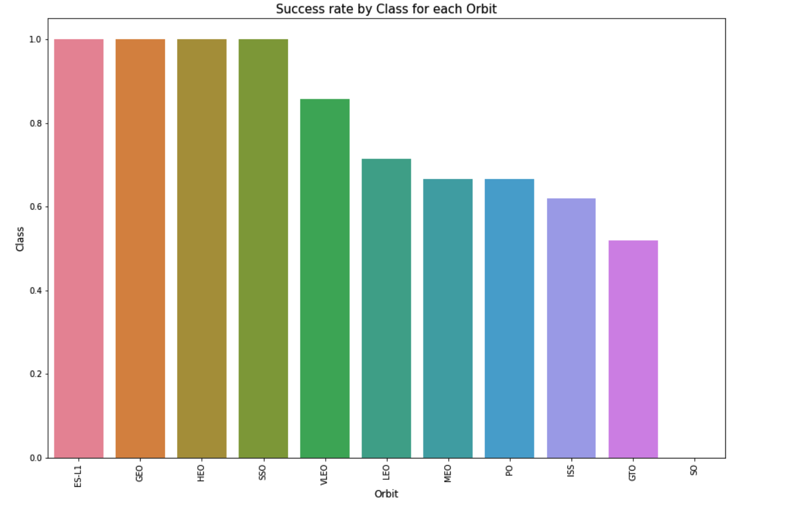
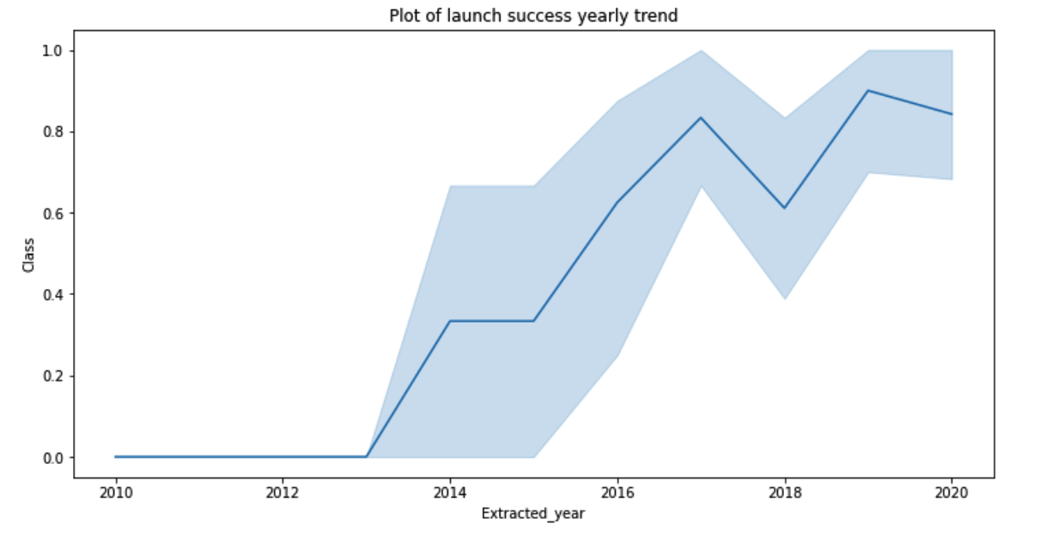
EDA with Data Visualization
Survey the data visualizing the connection between flight number and payload and launch site, success rate of each orbit type, flight number and orbit type, the launch success by yearly trend
GitHub URL: EDA with Visualization

Slide 12
EDA with SQL
Loaded the SpaceX dataset into IBM DB2 and using the jupyter notebook to analyze the dataset
Applied EDA with SQL to get insight from the data. Wrote to find out for instance:
The unique names of each lunch site for each space mission
Total mass of payload by boosters launched by NASA (CRS)
Average mass of payload by booster version F9 v1.1
Total successful and failure outcomes for each mission
The failed landing outcomes of drone ship, launch site and booster version
GitHub URL: EDA with SQL

Slide 13
Build an Interactive Map with Folium
Marked all launch sites and visualize map objects such as markers, circles, lines to mark the success or failure of each of the site on the folium map.
Assigned the feature launch outcomes to class 0 (failure) and class 1 (success).
Using the color-labeled marker clusters and identified which launch site have relatively high success rate.
Calculated the distance of each of the launch site to its proximities. Example of the questions answered:
Are the launch sites located next to railways, highways, and coastlines?
Do launch sites maintain a certain distance absent from cities?

Slide 14
Build a Dashboard with Plotly Dash
Built an interactive dashboard with Plotly Dash
Plotted pie charts showing the total launches by certain sites
A scatter plot showing the relationship between the outcome and the payload mass in kilograms for each booster version
GitHub URL: space_dash.py

Slide 15
Predictive Analysis (Classification)
Transformed the data and divided our data into training and testing using numpy and pandas.
Utilizing GridSearchCV, constructed various machine learning models and adjusted various hyperparameters.
Used accuracy as our model's metric, enhanced the model through algorithm tuning and feature engineering.
Discovered the classification model that performed the best.
GitHub URL: Machine Learning Predictive Analysis

Slide 16
Results
Exploratory data analysis results
Interactive analytics demo in screenshots
Predictive analysis results

Slide 17

Section 2

Slide 18
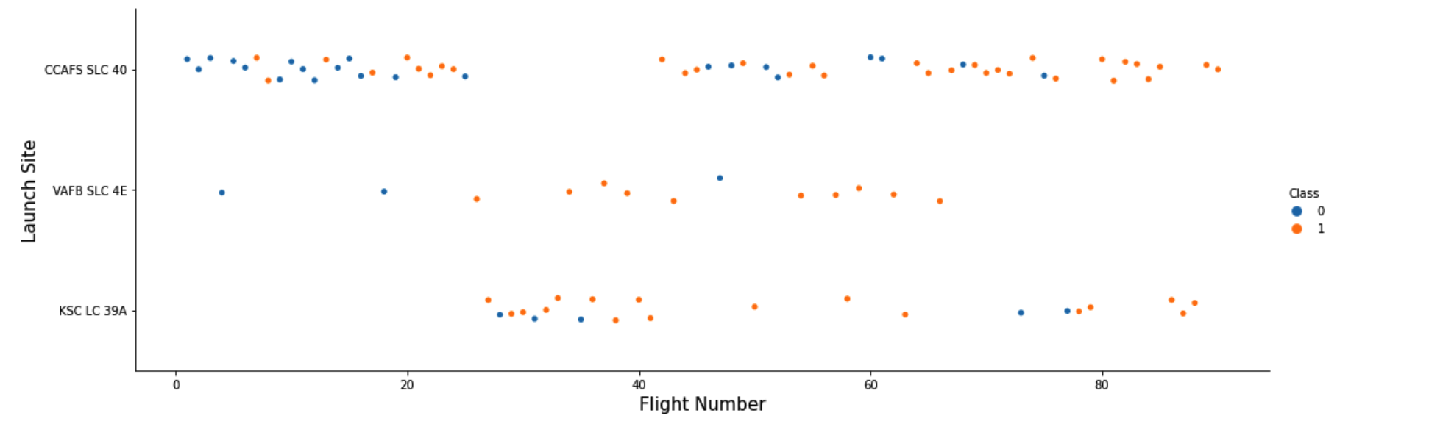
Flight Number vs. Launch Site
Discovered from the plot that a launch site's success rate was proportional to the flight volume.

Slide 19
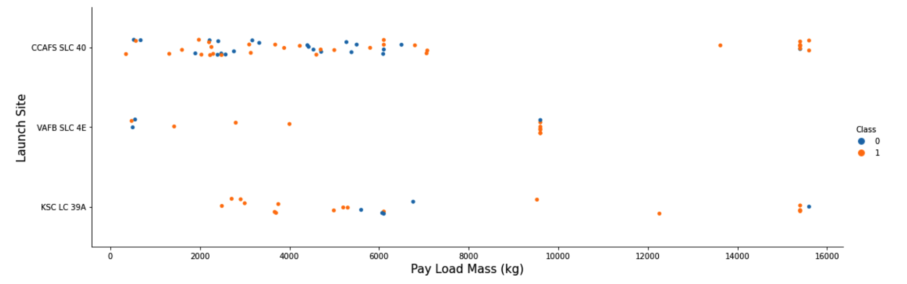
Payload vs. Launch Site
The greater the payload mass for launch site CCAFS SLC 40 the higher the success rate for the rocket.

Slide 20
Success Rate vs. Orbit Type
From the plot that ES-L1, GEO, HEO, SSO, and VLEO all had the highest success rates.

Slide 21
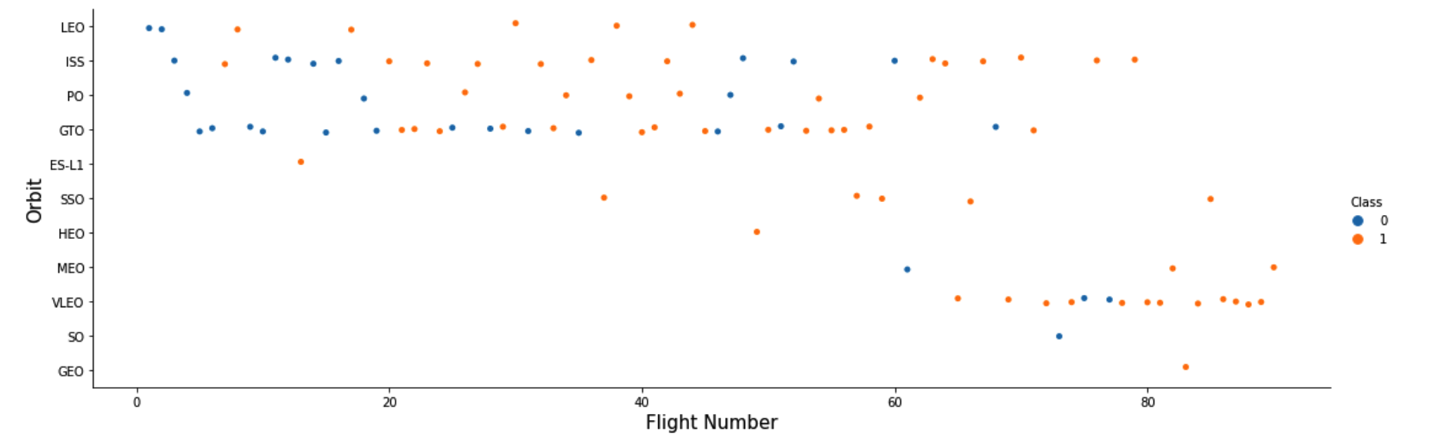
Flight Number vs. Orbit Type
The relationship between flight number and orbit type is depicted in the plot below.We see that in the LEO orbit, achievement is connected with the number of flights though in the GTO orbit, there is no connection between flight number and the orbit.

Slide 22
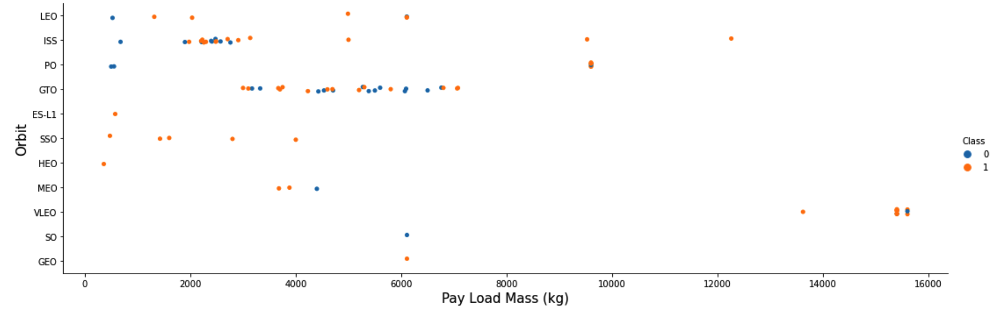
Payload vs. Orbit Type
Observe that PO, LEO, and ISS orbits are more frequently used for successful landings of heavy payloads.

Slide 23
Launch Success Yearly Trend
From the plot that the success rate has increased steadily since 2013 until 2020.

Slide 24
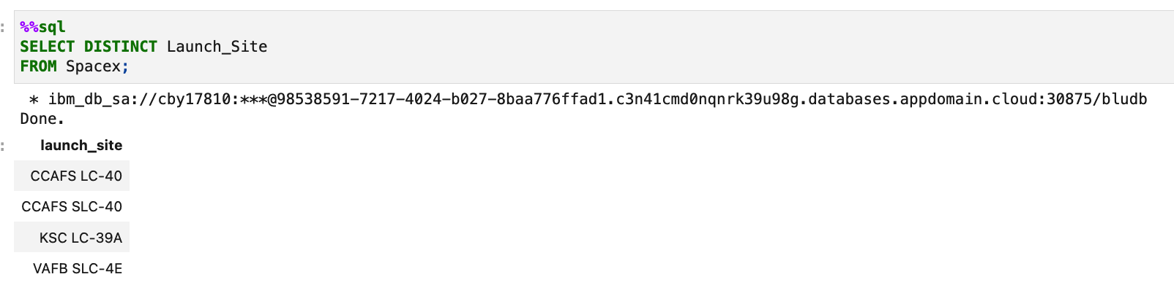
All Launch Site Names
Used the keyword "DISTINCT" to display only unique SpaceX data launch sites.

Slide 25
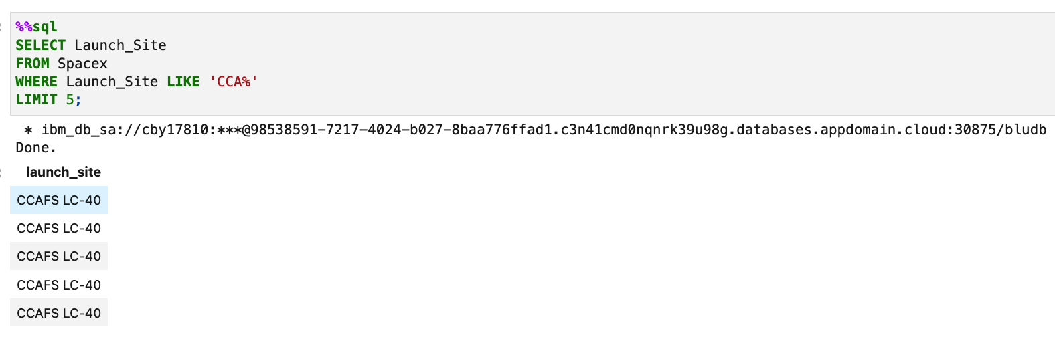
Launch Site Names Begin with 'CCA'
Used the query above to display five records containing the launch site prefix "CCA."

Slide 26
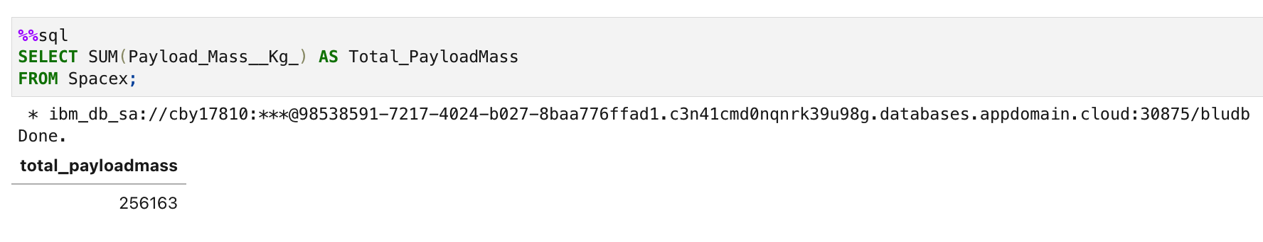
Total Payload Mass
Using the query below, determined that the total payload carried by NASA boosters was 256163.

Slide 27
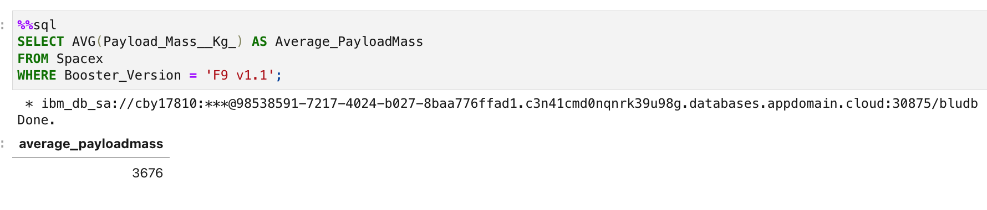
Average Payload Mass by F9 v1.1
Calculated that the booster version F9 v1.1 carried an average of 3676 kilograms of payload

Slide 28
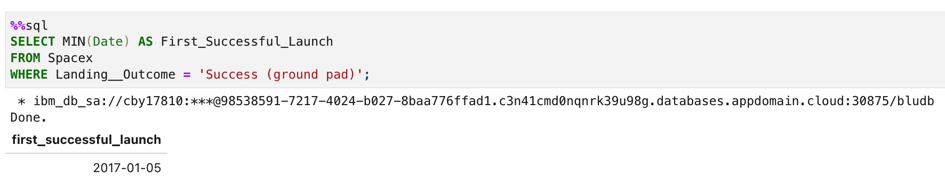
First Successful Ground Landing Date
Observed that the 5th of January 2017 marked the first successful landing on the ground pad.

Slide 29
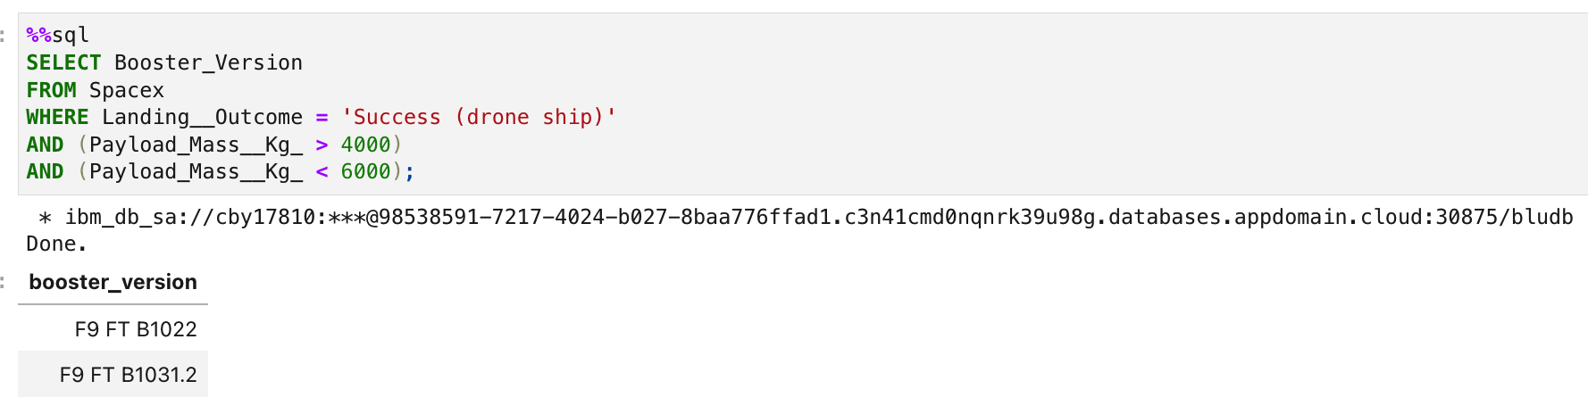
Successful Drone Ship Landing with Payload between 4000 and 6000
Utilized the “AND” condition to determine a successful landing with a payload mass greater than 4000 but less than 6000 and used the “WHERE” clause to search for boosters that had landed on the drone ship.

Slide 30
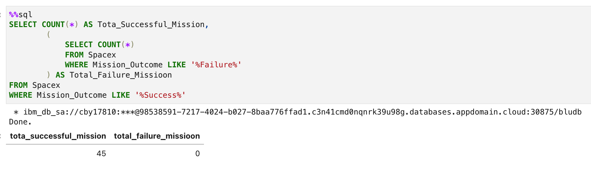
Total Number of Successful and Failure Mission Outcomes
Used a wildcard such as subquery and “%” to filter for "WHERE" Mission Outcome was successful or failure.

Slide 31
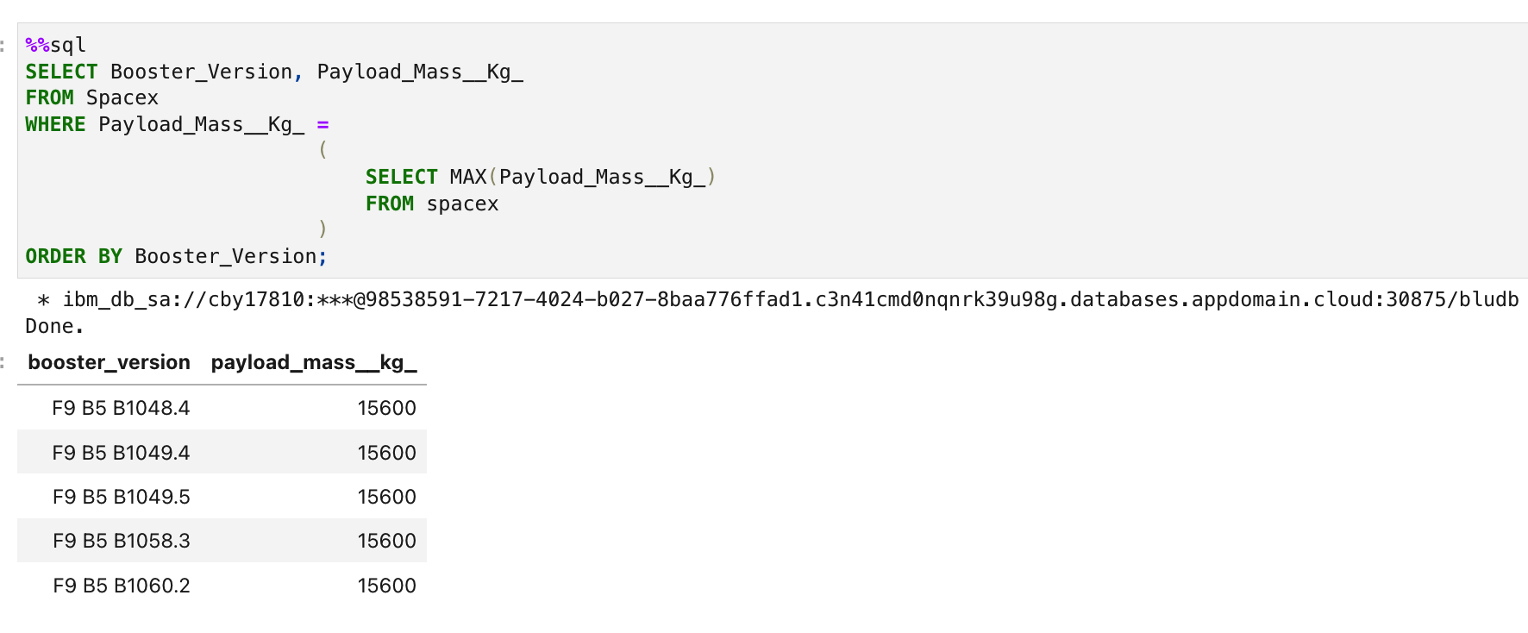
Boosters Carried Maximum Payload
Utilizing a subquery in the “WHERE” clause and the “MAX()” function, we were able to identify the booster that carried the most payload.

Slide 32
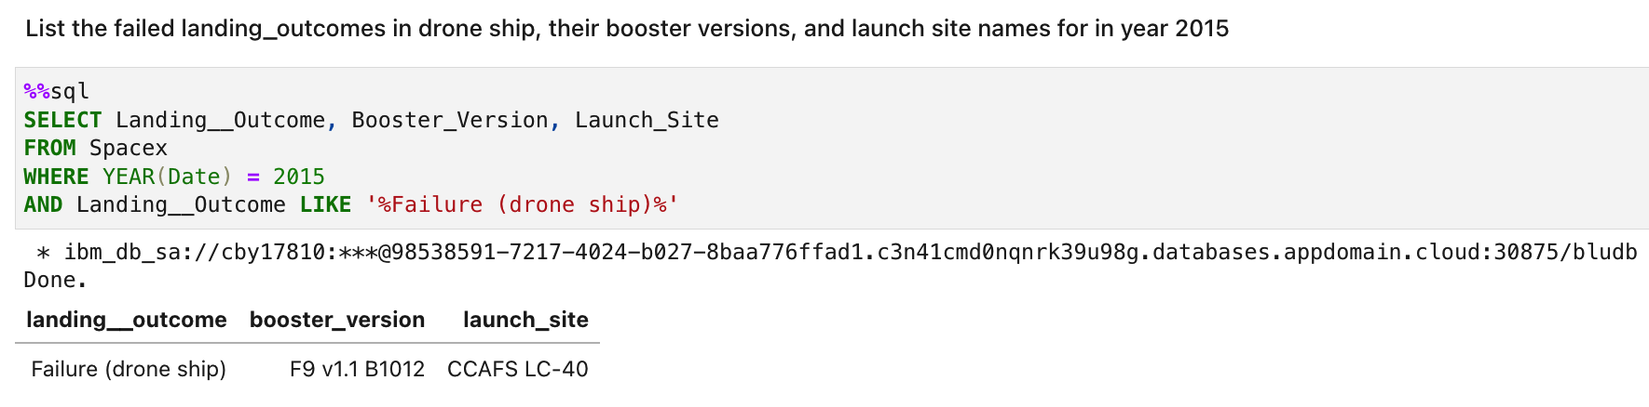
2015 Launch Records
Used a combinations of the WHERE clause, LIKE, “%”, AND, and BETWEEN conditions to filter for failed landing outcomes in drone ship, their booster versions, and launch site names for year 2015

Slide 33
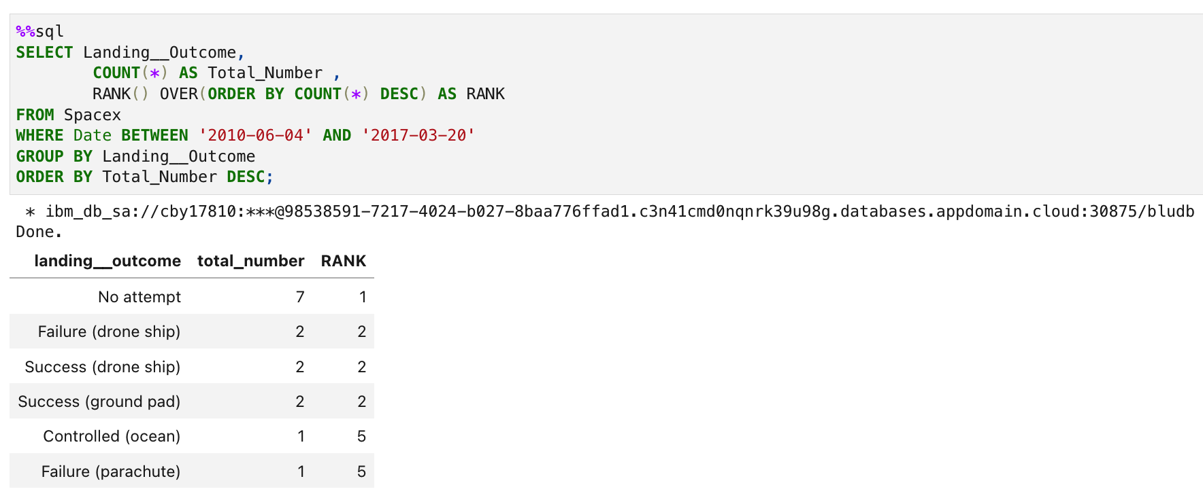
Rank Landing Outcomes Between 2010-06-04 and 2017-03-20
Selected the landing_outcome and “COUNT” of the landing outcomes from the data and “RANK” count of each of the landing outcomes and “ORDER BY” greatest to least and used “WHERE” to filter “YEAR” “BETWEEN” 2010 and 2017.
Applied the GROUP BY clause to group the landing outcomes and the ORDER BY clause to order the grouped landing outcome in descending order.

Slide 34

Section 3

Slide 35
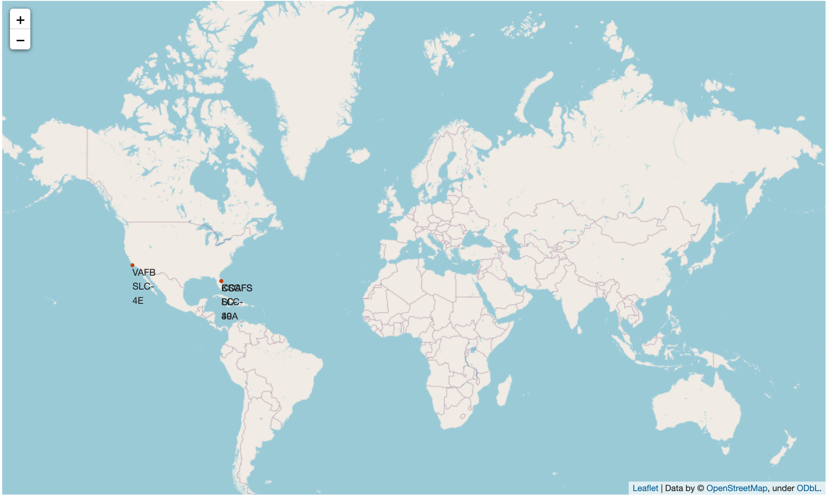
Location of all the launch sites global markers
All the launch sites are located in the US along the coasts of California and Florida

Slide 36
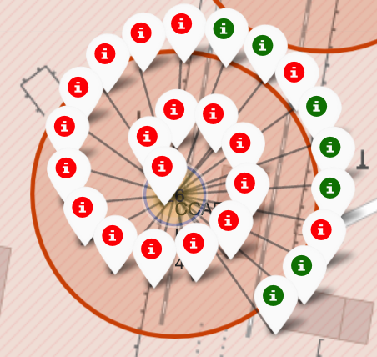
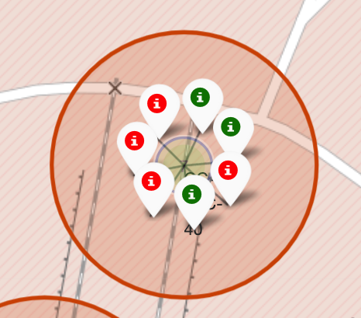
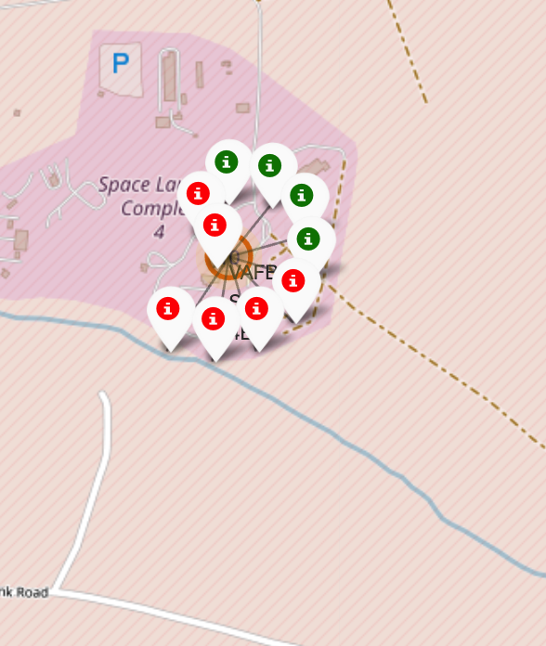
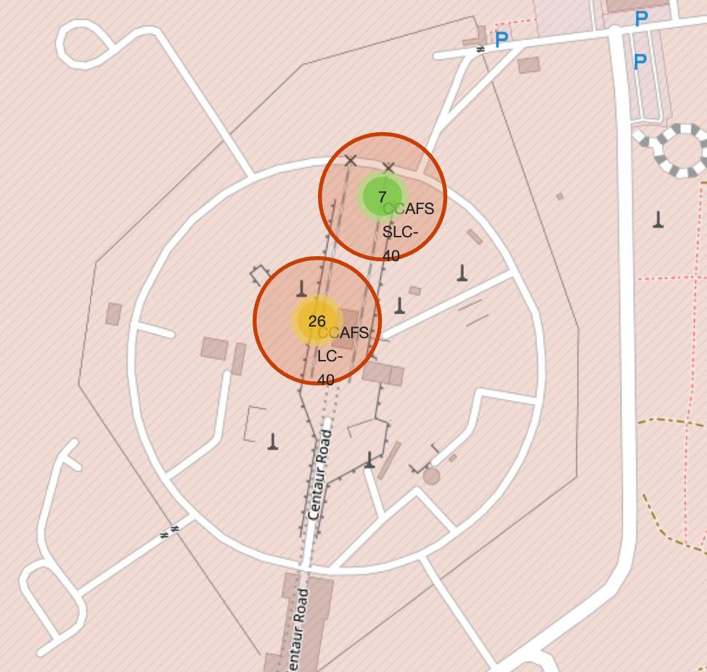
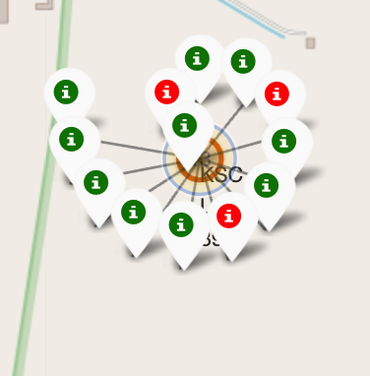
Location of the launch site with markers and color labels
Florida Launch Sites
California Launch Sites
Green Shows Successful and Red Shows Failed launches

Slide 37
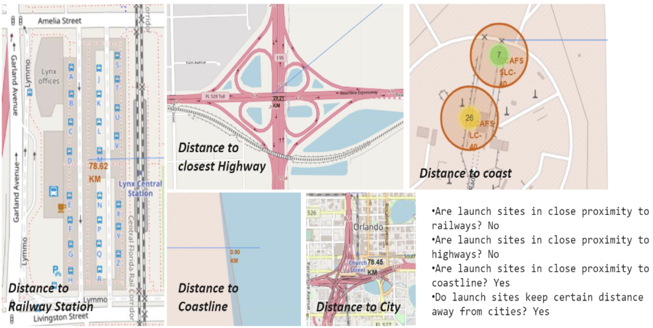
Railway, Highway, Coastline, and City distance to the Launch Site

Slide 38

Section 4

Slide 39
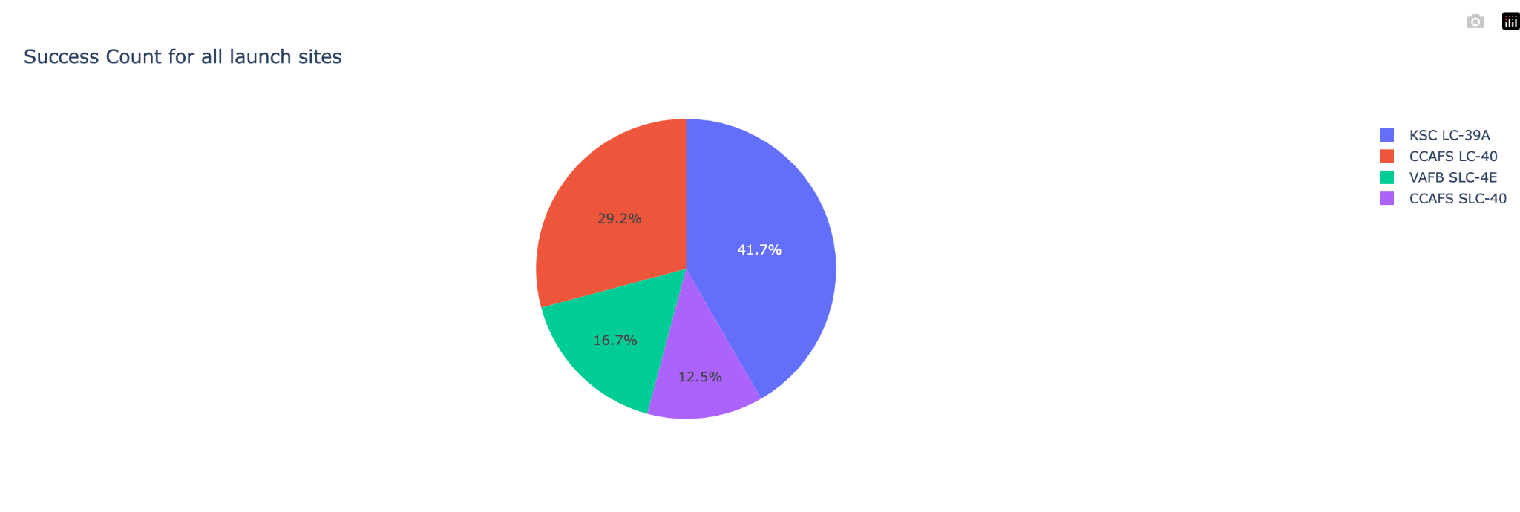
The pie chart shows the success of each of the launch site by percentage

Slide 40
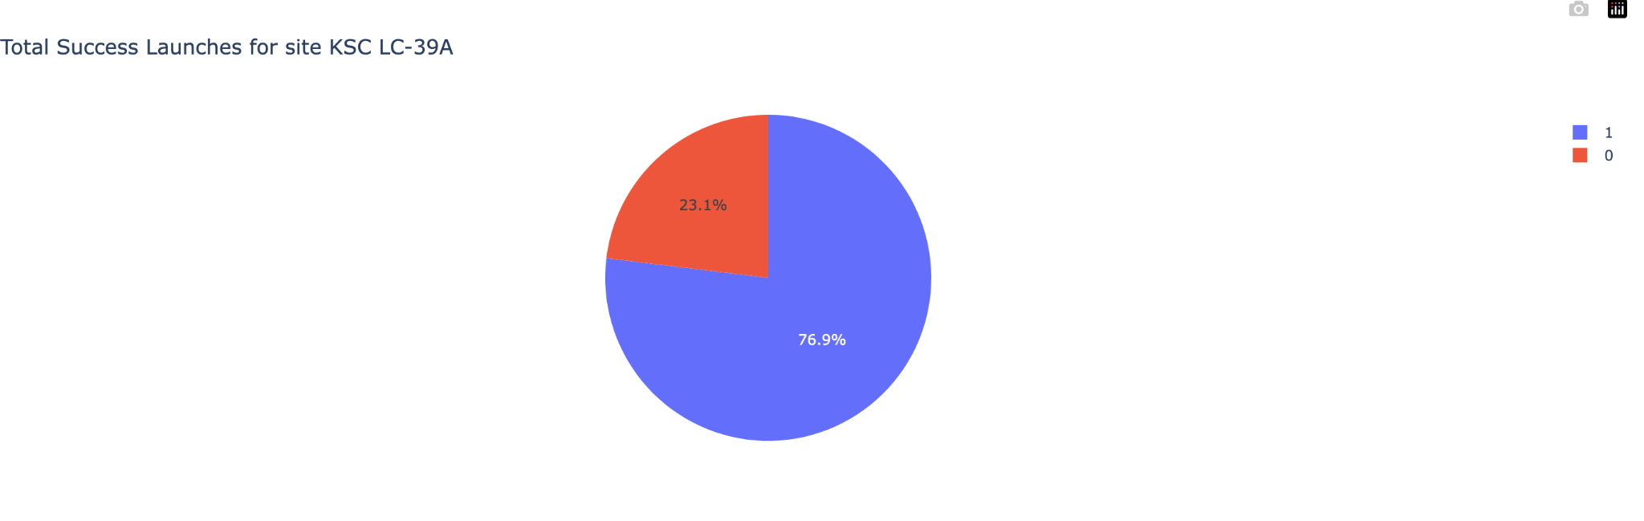
The pie chart shows the launch site with the highest launch success ratio
KSC LC-39A achieved a 76.9% success rate and 23.1% failure rate

Slide 41
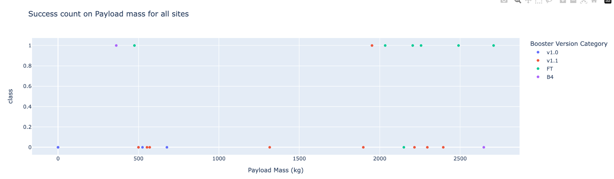
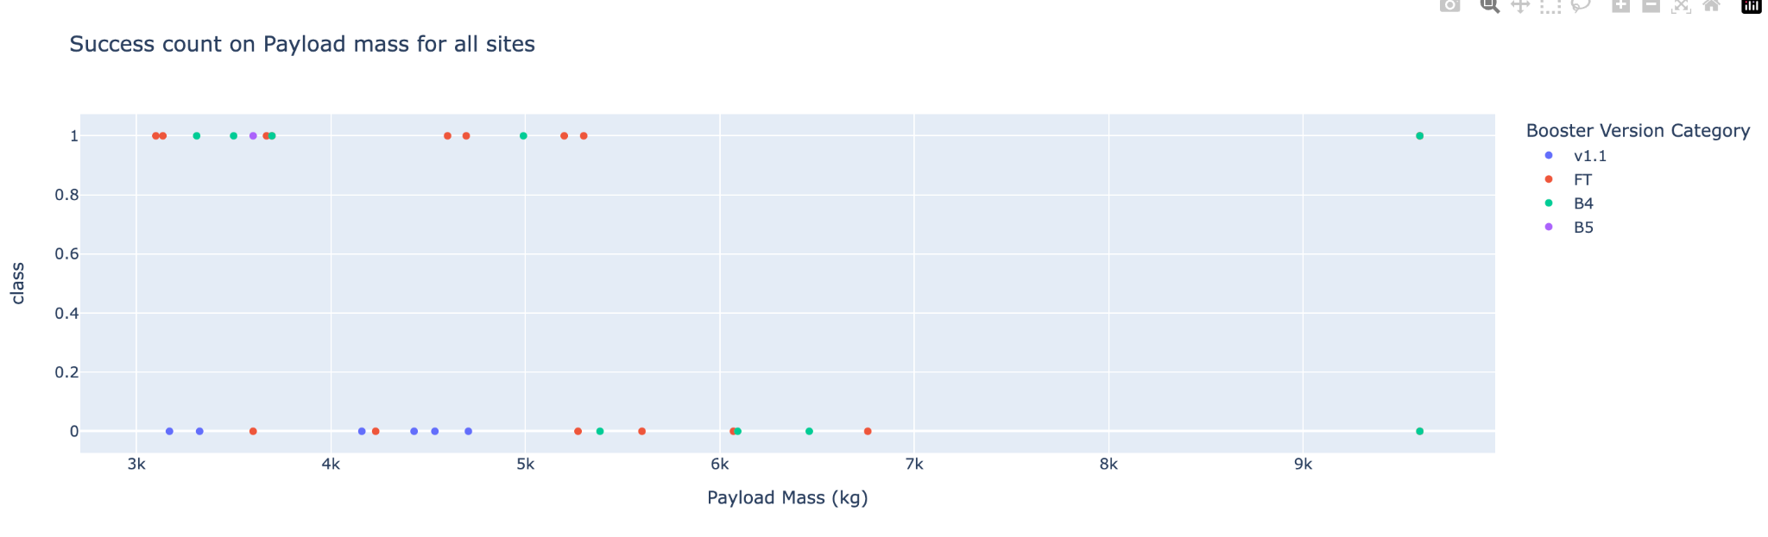
The scatter plots shows Payload vs Launch Outcome for all sites, with different payload mass selected by the range slider
These two scatter plots shows the success rate of the payload ranging from 0 - 3000 kg is higher than 3000 - 1000 kg
Payload between 0 kg to 3000 kg
Payload between 3000 kg to 10000 kg

Slide 42

Section 5

Slide 43
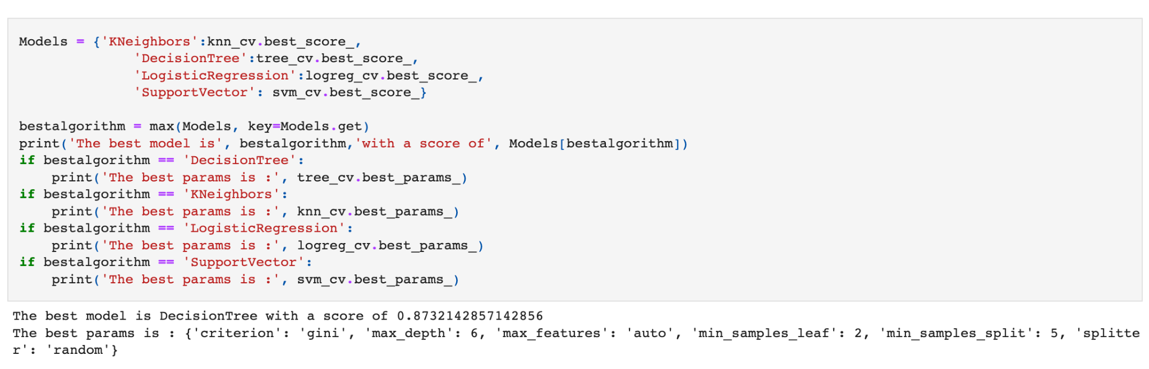
Classification Accuracy
The model with the highest classification accuracy is the decision tree classifier.

Slide 44
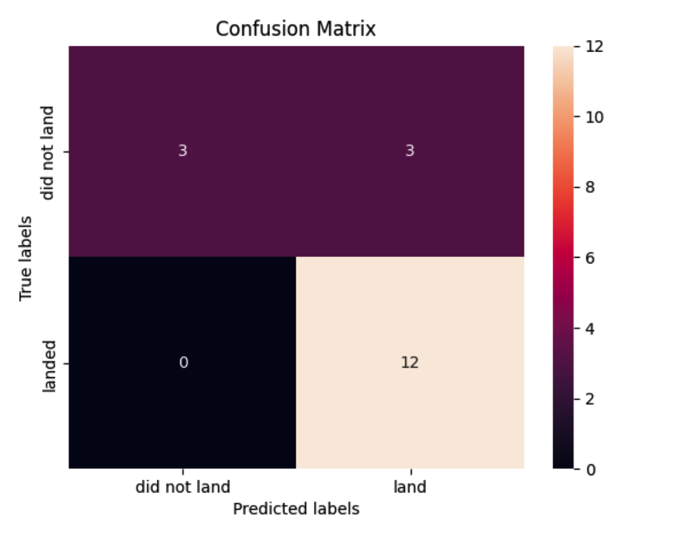
Confusion Matrix
The decision tree classifier confusion matrix demonstrates its ability to differentiate between the various classes. The biggest issue is false positives or failed landing is considered successful landing by the classifier.

Slide 45
Conclusions
In Conclusion:
The greatest success rate at a lunch site are the ones with larger flight amount.
From 2013 to 2020, the launch success rate has increased.
The most successful orbits were the ES-L1, GEO, HEO, SSO, and VLEO ones.
Launches at KSC LC-39A were the most successful of any site.
For this job, the best machine learning algorithm is the Decision Tree Classifier.

Slide 46


